Slide 1
COMMODITY MARKET
INTELLIGENCE PLATFORM
Data Engineering Internship | London Success Academy
Ajay Khadke | Akshay Londhe | June 2026
Platform: Snowflake Cloud Analytics | Datasets: Gold and Oil (Dec 2011 to Dec 2018)

Slide 2
Agenda
What we will cover today
01
Business Problem
Why this platform was commissioned
02
Data Understanding
1,718 gold records, 1,844 oil records, 87 columns
03
Data Quality
All 12 checks passed, logged to AUDIT.DQ_LOG
04
Architecture & Pipeline
Snowflake schema, automated Stream/Task flow, live dashboard
05
Hypothesis-Driven Insights
8 hypotheses tested: volatility, risk, correlation, safe-haven
06
Lessons Learned
What worked and what we would change
London Success Academy | Applied Data Engineering Internship | June 2026

Slide 3
01 Business Problem
Why this platform was commissioned
Data Silos
Market data stored in disconnected CSV files and spreadsheets
OUR MISSION
Manual Reporting
Build a reliable, scalable data platform that enables business users to access trusted information and make better decisions.
Analysts spend more time preparing reports than analysing trends
No Quality Checks
Data quality issues are difficult to detect and track
No Central Platform
No single place to store, query, or visualise commodity data
Slow Decisions
Executives cannot easily answer time-sensitive market questions
London Success Academy | Applied Data Engineering Internship | June 2026

Slide 4
02 Data Understanding
3,562 records across two commodity datasets
GOLD | gold_stocks_price.csv
OIL | oil_price.csv
Trading Days:
1,718
Trading Days:
1,844
Columns:
81
Columns:
6
Date Range:
Dec 2011 to Dec 2018
Date Range:
Dec 2011 to Dec 2018
All-time High:
$173.61 (Oct 2012)
All-time High:
$110.53 (Sep 2013)
All-time Low:
$100.50 (Dec 2015)
All-time Low:
$26.21 (Feb 2016)
7yr Average:
$127.32
7yr Average:
$70.44
Std Deviation:
$17.54
2013-16 Crash:
-76.3% drawdown
Date Format:
DD/MM/YYYY
Date Format:
YYYY-MM-DD
London Success Academy | Applied Data Engineering Internship | June 2026

Slide 5
03 Data Quality
All 12 checks passed; data approved for pipeline promotion
Check Name
Dataset
Issues
Result
Null / Blank Dates
GOLD
0
PASS
Duplicate Dates
GOLD
0
PASS
Null Price / Volume
GOLD
0
PASS
Non-positive Close
GOLD
0
PASS
OHLC Logic Violation
GOLD
0
PASS
Null / Blank Dates
OIL
0
PASS
Duplicate Dates
OIL
0
PASS
Non-positive Close
OIL
0
PASS
OHLC Logic Violation
OIL
0
PASS
Every result is stored in AUDIT.DQ_LOG with severity, % affected and a timestamp, so quality can be monitored over time.
London Success Academy | Applied Data Engineering Internship | June 2026

Slide 6
04 Platform Architecture
Snowflake Cloud: 4-layer schema plus Snowflake-native features
01 RAW
02 STAGING
03 ANALYTICS
04 AUDIT
gold_stocks_price.csv
oil_price.csv
STG_GOLD_MARKET
STG_OIL_MARKET
FACT_GOLD / OIL
DIM_DATE + 6 Views
DQ_LOG
VARCHAR staging, file metadata, _LOADED_AT timestamps
TRY_TO_* casting, OHLC validation, deduplication via ROW_NUMBER()
MA7/30/90, volatility, drawdown, correlation, cross signals
Persistent quality log, severity classification, stored procedure
Snowflake-native extras: Stream and Task for auto-ingest, Time Travel for audit, Zero-copy Clone for a dev sandbox, Stored Procedure for DQ automation
London Success Academy | Applied Data Engineering Internship | June 2026

Slide 7
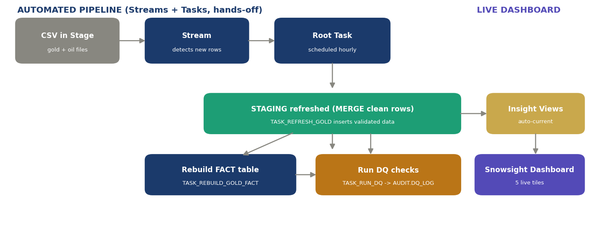
04 Automated Pipeline & Dashboard
New data flows from raw file to live dashboard with no manual step
HOW IT RUNS
1 Stream detects new raw rows
2 Root Task cleans, loads to staging
3 Child Task rebuilds fact table
4 DQ Task logs quality to audit
5 Views refresh automatically
The Task only burns credits when the Stream has new data, so an idle pipeline is effectively free.
6 Dashboard 5 tiles redraw
London Success Academy | Applied Data Engineering Internship | June 2026

Slide 8
05 Hypothesis-Driven Insights
We stated 8 business hypotheses, then proved or disproved each with the data
Hypothesis
Verdict
Evidence
Oil is far more volatile than gold
PROVEN
2.1x more volatile (32.5% vs 15.3%)
A strong US dollar pushes gold down
PROVEN
Price correlation -0.72
Gold is a safe haven in equity sell-offs
PARTLY
+0.20% on worst 5% S&P days
Gold and oil move together (no diversification)
DISPROVEN
Correlation flips: -0.31 to +0.51 to 0
High volume signals big price moves
PROVEN
r = 0.63; top days move 3x more
Volatility clusters (risk is persistent)
PROVEN
Oil autocorrelation +0.28
Extreme >2% daily moves are rare
MIXED
Gold 4.3% of days, oil 24.3%
Oil drawdown risk far exceeds gold
PROVEN
Oil -76.3% vs gold -42.1%
London Success Academy | Applied Data Engineering Internship | June 2026

Slide 9
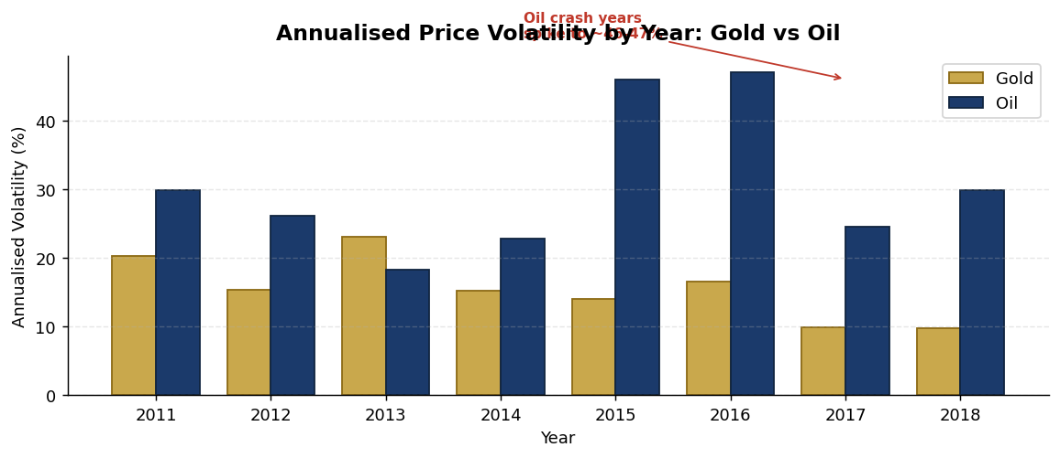
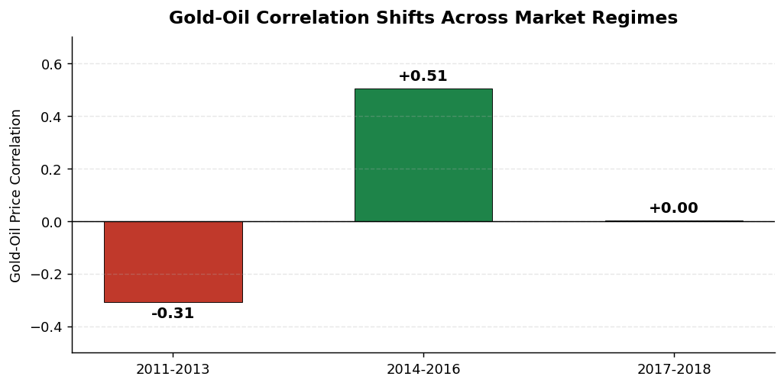
05 Spotlight: Volatility & Risk
The reviewer asked us to dig into volatility. Here is what we found.
KEY RISK FINDINGS
Oil is 2.1x more volatile
Annualised: oil 32.5%, gold 15.3%. Every year, no exceptions.
Volatility clusters
Turbulent days follow turbulent days (autocorr +0.28). Risk is persistent.
Correlation is unstable
Gold-oil link swings from -0.31 to +0.51 across regimes.
Oil drawdown twice as deep
Worst loss: oil -76.3% vs gold -42.1%.
London Success Academy | Applied Data Engineering Internship | June 2026

Slide 10
06 Lessons Learned
What worked and what we would change
What Went Well
What We Would Improve
✓ Layered schema kept raw data intact and fully auditable
→ Build DIM_DATE before the fact tables; the dependency surfaced late
✓ Persistent DQ_LOG enables trend monitoring across pipeline runs
→ Check oil CSV encoding before loading; the K volume format broke parsing
✓ Snowflake features (Stream, Task, Clone) set the build apart
→ Create a unified data dictionary for all 81 gold columns at project start
✓ DIM_DATE month-end and quarter-end flags help reporting straight away
→ Add a date alignment check (oil holds 126 more records than gold)
✓ Automated Stream and Task pipeline feeds a live Snowsight dashboard with no manual step
→ Automate the full pipeline end-to-end via Task chain from day one
London Success Academy | Applied Data Engineering Internship | June 2026

Slide 11
THANK YOU
Commodity Market Intelligence Platform
London Success Academy | Applied Data Engineering Internship | June 2026
1,718
1,844
12/12
8
Gold Records
Oil Records
DQ Checks Passed
Hypotheses Tested
Platform: Snowflake | Schemas: RAW, STAGING, ANALYTICS, AUDIT | Extras: Stream and Task, Time Travel, Zero-copy Clone, Stored Procedure

